Slide 1
Data Analysis and visualization
Instructor: EESHA TUR RAZIA BABAR
Notes:
hn56duy

Slide 2


About Myself
Education
MSc in Electrical and Computer Engineering
University of California Irvine, 2023
BSc in Electrical Engineering
University of Engineering and Technology, 2019

Slide 3
Publications
• Butt, A.A. et al. (2024) 2024 ASEE Annual Conference & Exposition, Board 62: Work in progress: A
Comparative Analysis of Large Language Models and NLP Algorithms to Enhance Student Reflection
Summaries | American Society for Engineering Education. Available at:
https://nemo.asee.org/public/conferences/344/papers/42399/view (Accessed: 02 August 2024).
• babar, E. tur razia and U Rahman, M. (2021) A smart, low cost, wearable technology for Remote Patient
Monitoring | IEEE Journals & Magazine | IEEE Xplore, Available at:
https://ieeexplore.ieee.org/document/9500225/ (Accessed: 02 August 2024).
• Pasha, S. et al. (2021) A low-cost, automated, portable mechanical ventilator for Developing World
| IEEE Conference Publication | IEEE Xplore, Available at: https://ieeexplore.ieee.org/document/9612508
(Accessed: 02 August 2024).
• babar, E. tur razia et al. (2020) A smart, low cost, wearable technology for Remote Patient Monitoring | IEEE
conference publication | IEEE Xplore, Available at: https://ieeexplore.ieee.org/document/9058401
(Accessed: 02 August 2024).
FAST NCES – INTRODUCTION TO DATA SCIENCE
3

Slide 4
WHY BOTHER? JOB PERSPECTIVE
Data Scientist
Data Analyst
Data Engineer
Data Mining Specialist
Data Mining Consultant
4
Notes:
Data analysts typically work with structured data to solve tangible business problems using tools like SQL, R or Python programming languages, data visualization software, and statistical analysis. Common tasks for a data analyst might include:
Collaborating with organizational leaders to identify informational needs
Acquiring data from primary and secondary sources
Cleaning and reorganizing data for analysis
Analyzing data sets to spot trends and patterns that can be translated into actionable insights
Presenting findings in an easy-to-understand way to inform data-driven decisions
Read more: What Does a Data Analyst Do? A Career Guide
Data scientists often deal with the unknown by using more advanced data techniques to make predictions about the future. They might automate their own machine learning algorithms or design predictive modeling processes that can handle both structured and unstructured data. This role is generally considered a more advanced version of a data analyst. Some day-to-day tasks might include:
Gathering, cleaning, and processing raw data
Designing predictive models and machine learning algorithms to mine big data sets
Developing tools and processes to monitor and analyze data accuracy
Building data visualization tools, dashboards, and reports
Writing programs to automate data collection and processing
Data engineers focus on managing and organizing data, building and maintaining databases and data pipelines, while data scientists focus on analyzing and interpreting data to find insights and patterns.

Slide 5
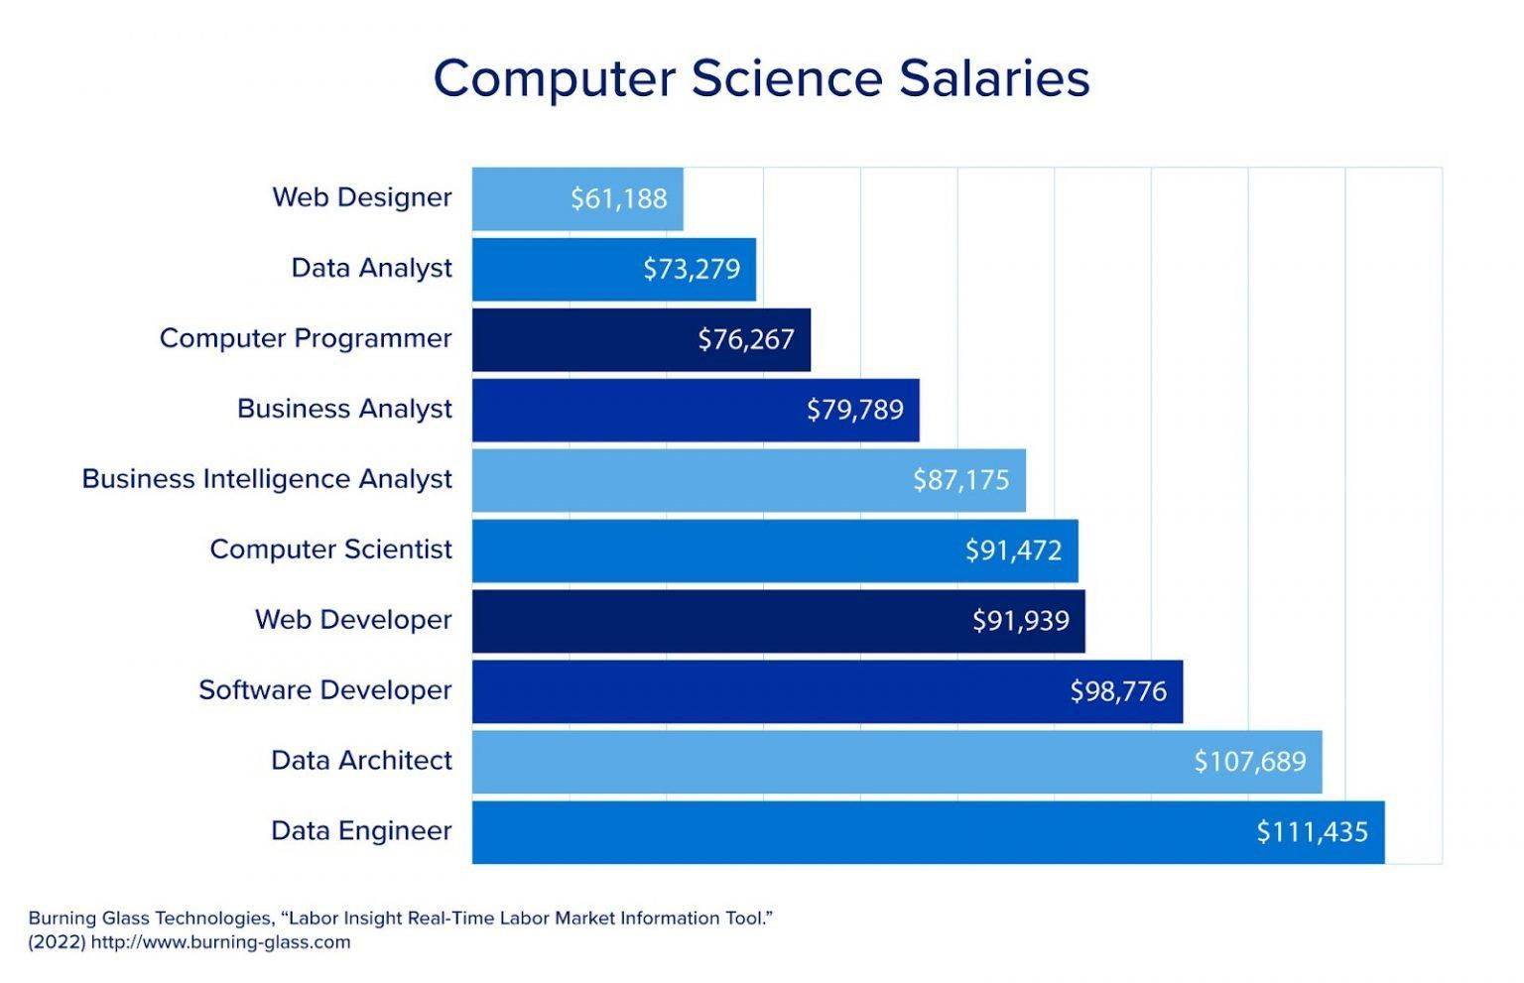
2023 HIGHEST PAYING JOBS
5

Slide 6
Introduction
Notes:
https://www.geeksforgeeks.org/what-is-data-analysis/#why-data-analysis-is-important
https://www.datacamp.com/blog/what-is-data-analysis-expert-guide
Data is Everywhere, in sheets, in social media platforms, in product reviews and feedback, everywhere. In this latest information age it’s created at blinding speeds and, when data is analyzed correctly, can be a company’s most valuable asset. “To grow your business even to grow in your life, sometimes all you need to do is Analysis!”
https://www.simplilearn.com/data-analysis-methods-process-types-article
https://ankitanshu.medium.com/phases-of-data-analysis-process-b2862c8b62d2
https://towardsdatascience.com/tips-for-effective-data-visualization-d4b2af91db37

Slide 7
Data Analysis
Data is raw information, and analysis of data is the systematic process of interpreting and transforming that data into meaningful insights to support decision making.
Analysis may involves applying statistical, mathematical, or computational techniques to extract patterns, trends, and correlations from datasets.
Notes:
Data analysis is the process of inspecting, cleaning, transforming, and modeling data to discover useful information, draw conclusions, and support decision-making. It involves the application of various techniques and tools to extract meaningful insights from raw data, helping in understanding patterns, trends, and relationships within a dataset.
Data and analysis together form the backbone of evidence-based decision-making, enabling organizations and individuals to understand complex phenomena, predict outcomes, and derive actionable conclusions for improved outcomes and efficiency.
Student performance in a particular subject, a single student performance in a subject
Diagnosis. Which symtoms led to Covid-19
Global warming
General sale is higher now because Some product sale is higher

Slide 8
Why it is important?
Informed Decision-Making
Business Intelligence
Problem Solving
Performance Evaluation
Risk Management
Optimizing Processes
Notes:
Informed Decision-Making: Analysis of data provides a basis for informed decision-making by offering insights into past performance, current trends, and potential future outcomes.
Business Intelligence: Analyzed data helps organizations gain a competitive edge by identifying market trends, customer preferences, and areas for improvement.
Covid days masks etc, Manto, location,
Problem Solving: It aids in identifying and solving problems within a system or process by revealing patterns or anomalies that require attention.
Performance Evaluation: Analysis of data enables the assessment of performance metrics, allowing organizations to measure success, identify areas for improvement, and set realistic goals. Feedback etc
Risk Management: Understanding patterns in data helps in predicting and managing risks, allowing organizations to mitigate potential challenges.
Weather reports, market surge, market slow down
Optimizing Processes: Data analysis identifies inefficiencies in processes, allowing for optimization and cost reduction.
Industries, look for things that are taking too much cost,

Slide 9
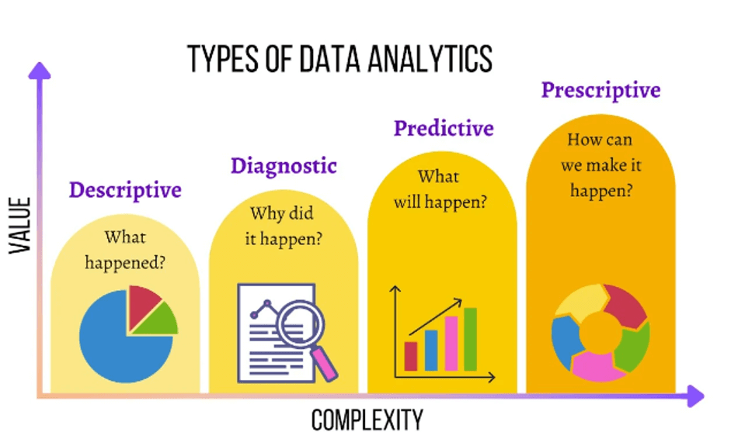

Slide 10
Descriptive analysis
It involves analyzing historical data to understand what has happened in the past.
This type of analysis is used to identify patterns and trends over time.
Example: Let’s take the example of DMart, we can look at the product’s history and find out which products have been sold more or which products have large demand by looking at the product sold trends, and based on their analysis we can further make the decision of putting a stock of that item in large quantity for the coming year.
Notes:
a business might use descriptive analysis to understand the average monthly sales for the past year.

Slide 11
Diagnostic Analysis
Diagnostic analysis goes a step further than descriptive analysis by determining why something happened.
It involves more detailed data exploration and comparing different data sets to understand the cause of a particular outcome.
Example: Let’s take the example of Dmart again. Now if we want to find out why a particular product has a lot of demand, is it because of their brand or is it because of quality. All this information can easily be identified using diagnostic Analysis.
Notes:
if a company's sales dropped in a particular month, diagnostic analysis could be used to find out why.

Slide 12
Predictive analysis
Predictive analysis uses statistical models and forecasting techniques to understand the future.
It involves using data from the past to predict what could happen in the future.
This type of analysis is often used in risk assessment, marketing, and sales forecasting.
Example: The best example would be Amazon and Netflix recommender systems. You might have noticed that whenever you buy any product from Amazon, on the payment side it shows you a recommendation saying the customer who purchased this has also purchased this product that recommendation is based on the customer purchase behavior in the past. By looking at customer past purchase behavior analyst creates an association between each product and that’s the reason it shows recommendation when you buy any product.
Notes:
a company might use predictive analysis to forecast the next quarter's sales based on historical data.

Slide 13
Prescriptive analysis
Prescriptive analysis is the most advanced type of data analysis.
It not only predicts future outcomes but also suggests actions to benefit from these predictions.
It uses sophisticated tools and technologies like machine learning and artificial intelligence to recommend decisions.
The best example would be Google’s self-driving car, by looking at the past trends and forecasted data it identifies when to turn or when to slow down, which works much like a human driver.
Notes:
a prescriptive analysis might suggest the best marketing strategies to increase future sales.
Statistical Analysis
Regression Analysis
Cohort Analysis
Time Series Analysis
Factor Analysis
Text Analysis

Slide 14
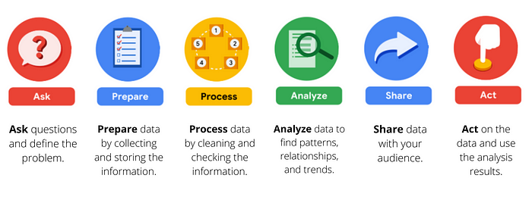
Data analysis process

Slide 15
Step 1: Defining objectives and questions
The first phase of the data analysis process is asking the right questions.
Define the objectives and formulate clear, specific questions that your analysis aims to answer.
It involves understanding the problem or situation at hand, identifying the data needed to address it, and defining the metrics or indicators to measure the outcomes.
Notes:
Why student drop out of college?

Slide 16
Step 2: Data collection
The second phase is to prepare the data.
Preparing your data means collecting or using the data relevant to the problem you are trying to solve.
The common sources from where the data is collected are Interviews, Surveys, Feedback, Questionnaires, Forms or scrapping.
Notes:
The data collected can be quantitative (numerical) or qualitative (non-numerical), depending on the nature of the problem and the questions being asked.
Garbage in equals garbage out.

Slide 17
Step 3: Data cleaning
The third phase is to process the data.
It involves checking the data for errors and inconsistencies, and correcting or removing them.
Checking as much as possible for bias in the data
Maintain data Integrity
Notes:
Address missing values, handle outliers, and transform the data into a usable format. Cleaning and preprocessing steps are crucial for ensuring the accuracy and reliability of the analysis.

Slide 18
Step 4: Data analysis
The primary goal in this phase is to find the relationships, trends, and patterns that will help you solve your business problem more accurately.
Use tools to format, transform, sort and filter data
Identify patterns and draw conclusions
Make data-driven decisions
Notes:
Exploratory Data Analysis (EDA): Conduct exploratory analysis to understand the characteristics of the data. Visualize distributions, identify patterns, and calculate summary statistics. EDA helps in formulating hypotheses and refining the analysis approach.
Statistical Analysis or Modeling: Apply appropriate statistical methods or modeling techniques to answer the defined questions. This step involves testing hypotheses, building predictive models, or performing any analysis required to derive meaningful insights from the data.

Slide 19
Step 5: Data interpretation and visualization
After the data is analyzed, the next step is to interpret the results and visualize them in a way that is easy to understand.
This could involve creating charts, graphs, or other visual representations of the data.
Data visualization helps to make complex data more understandable and provides a clear picture of the findings.

Slide 20
Step 6: Data storytelling
This involves presenting the findings of the analysis in a narrative form that is engaging and easy to understand.
Data storytelling is crucial for communicating the results to non-technical audiences and for making data-driven decisions.
You will provide recommendations to the stakeholder on how to solve the business problem and help them make a good decision.

Slide 21
Data Visualization
The graphical representation of information and data

Slide 22
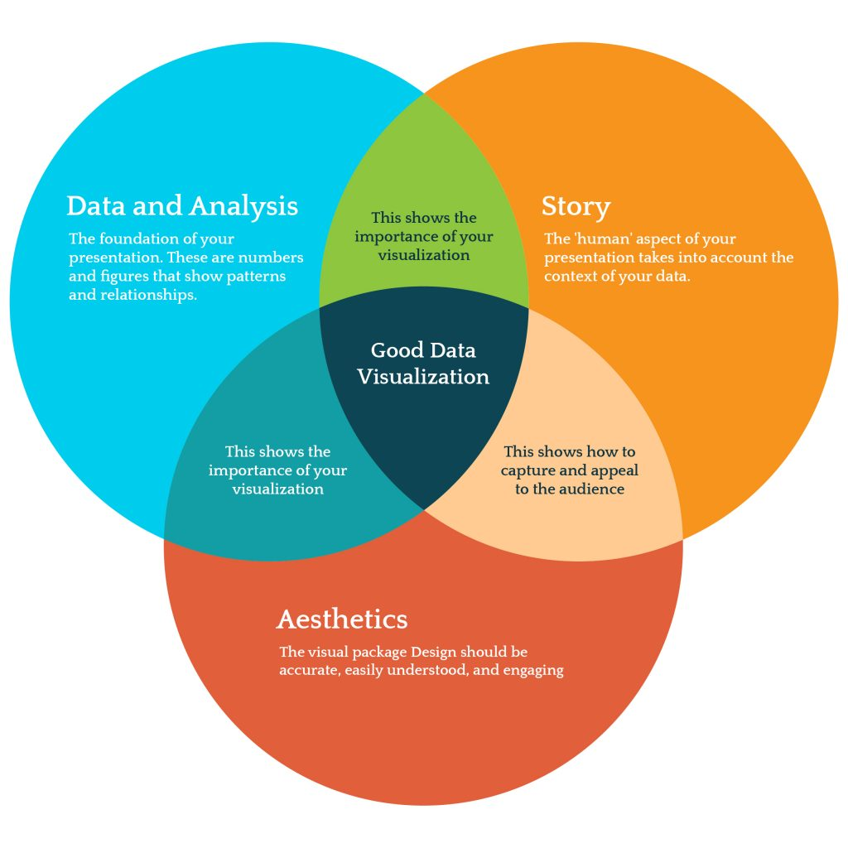

Slide 23
Why?
Reveals invisible parts in data
Analyze things that are otherwise difficult
Magnifies ability to understand things
Help us tell a story
Efficient way to understand Big Data
Notes:
70% of body’s sense receptors reside in our eyes
Reveals invisible parts in data that we don’t have access to otherwise
Analyze things that are otherwise difficult
See things at a level that is not available at our own perception
Magnifies our ability to understand things better
Help us tell a story
Need an efficient way to understand Big Data

Slide 24
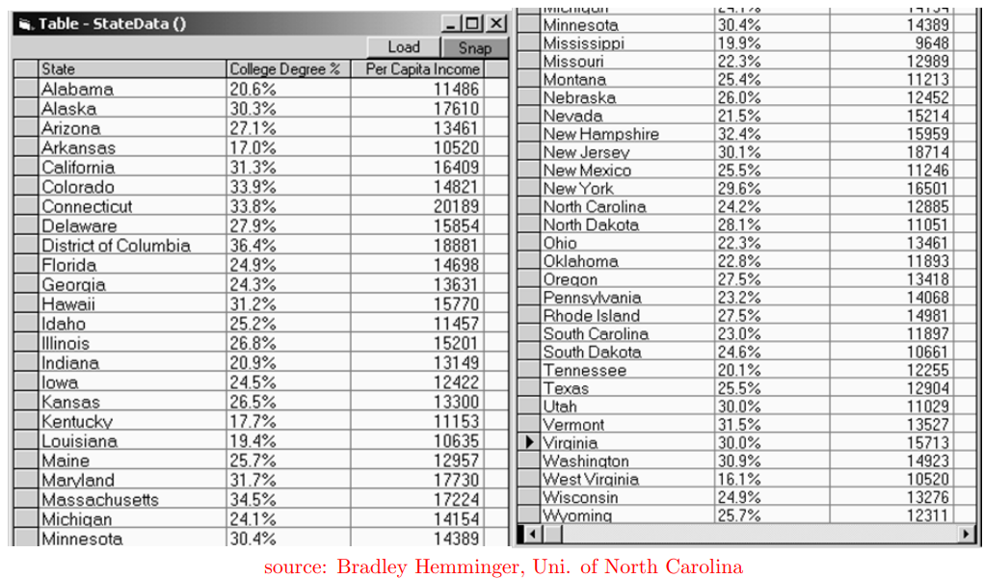
example
Which state has the largest and the smallest College degree and Per Capita income?
Which states are outliers if any?
How is income related to college degree?

Slide 25
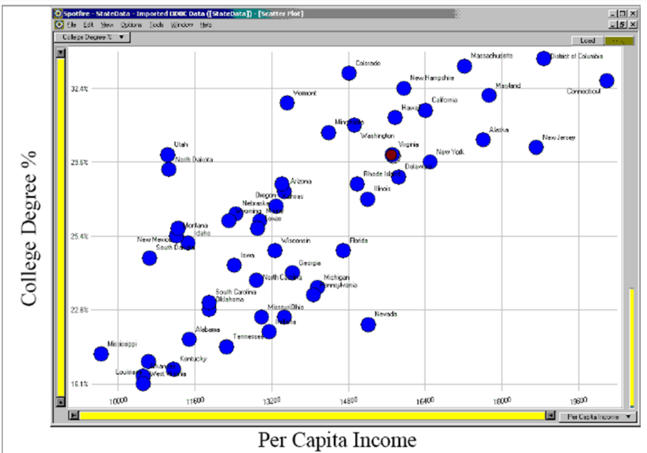
Can easily tell what is largest/smallest in every dimension

Slide 26
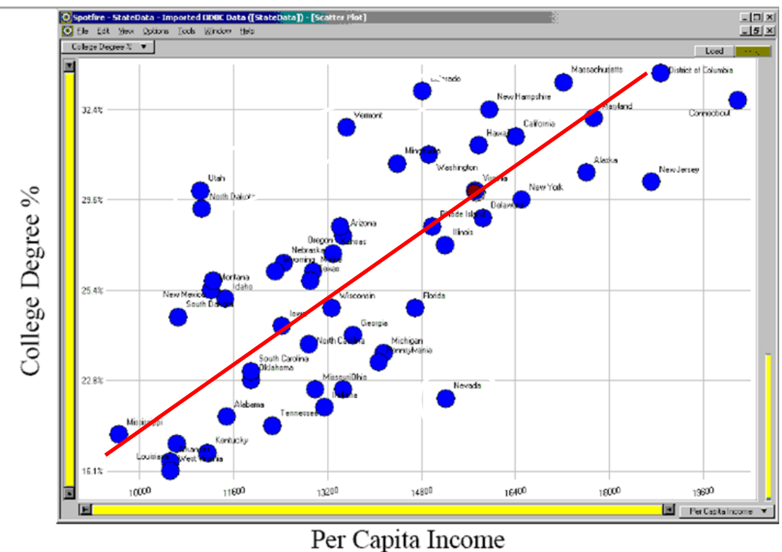
Visualization helps identify relationship easily as compared to raw data

Slide 27
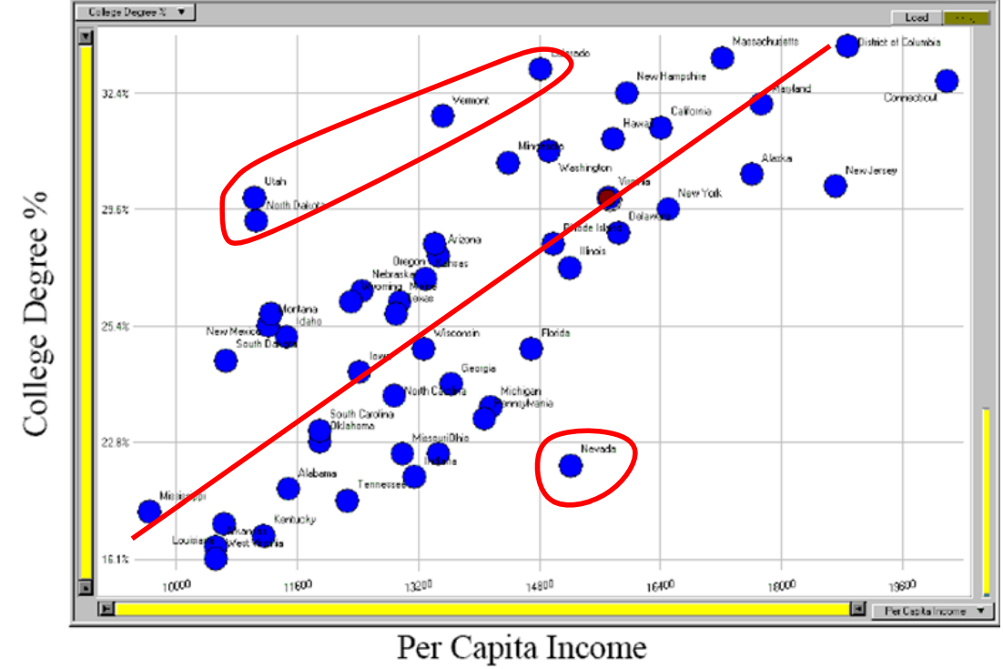
Outliers stand out and get identified easily

Slide 28
Uses of Data Visualization
Decision Making
Finding solution to problems
For understanding data clearly
To find relationship among data
Comparative analysis

Slide 29
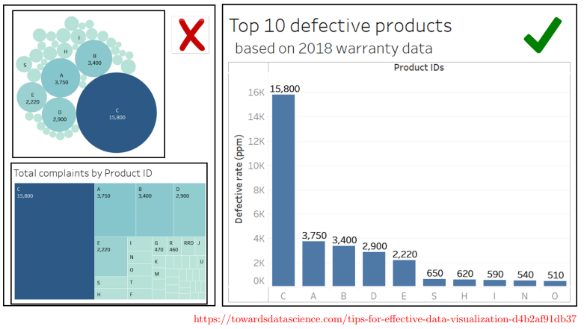
Chose right visuals, according to purpose

Slide 30
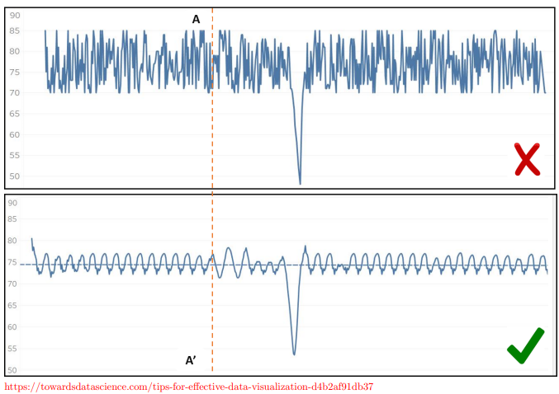
Focus on vital data points
Notes:
Remove noise,

Slide 31
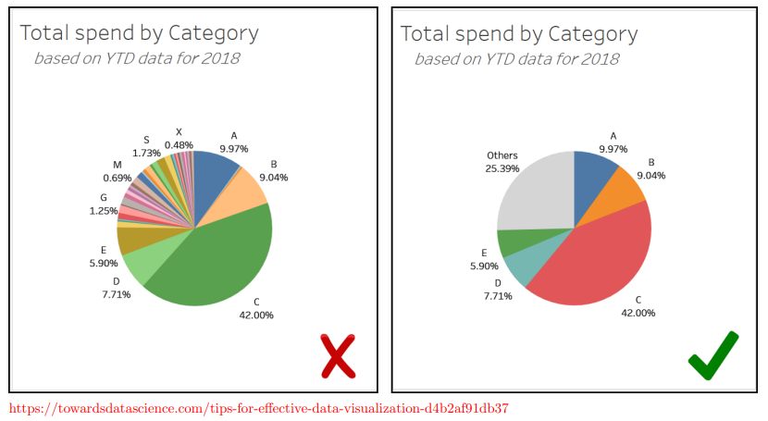
Suppress the noise

Slide 32
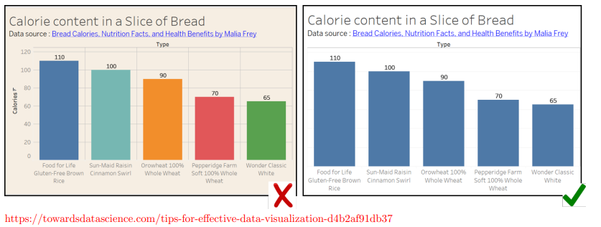
use colors wisely

Slide 33
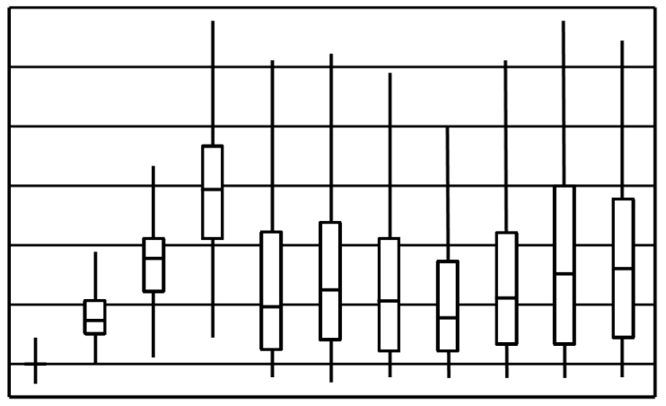
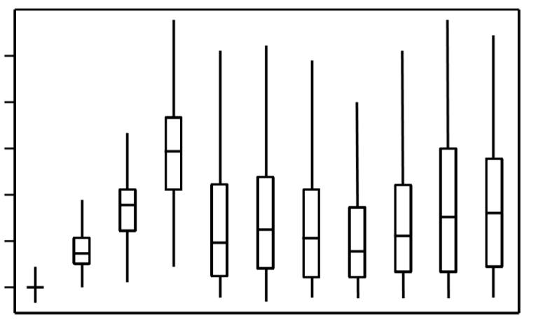
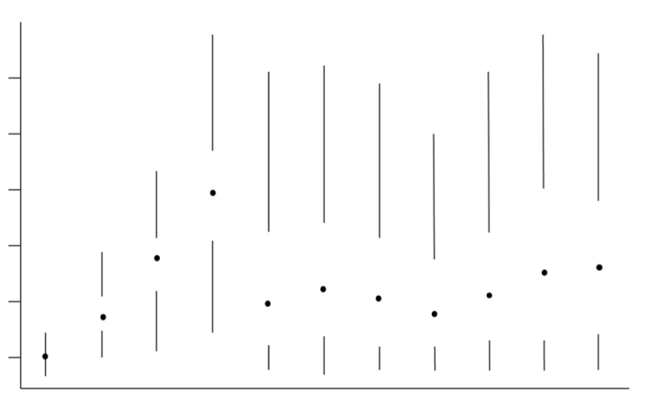
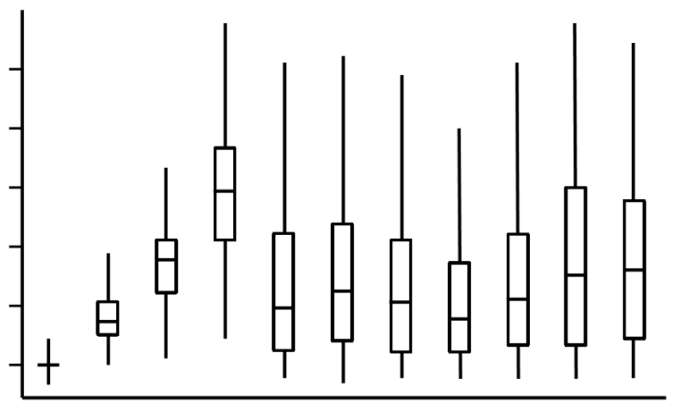
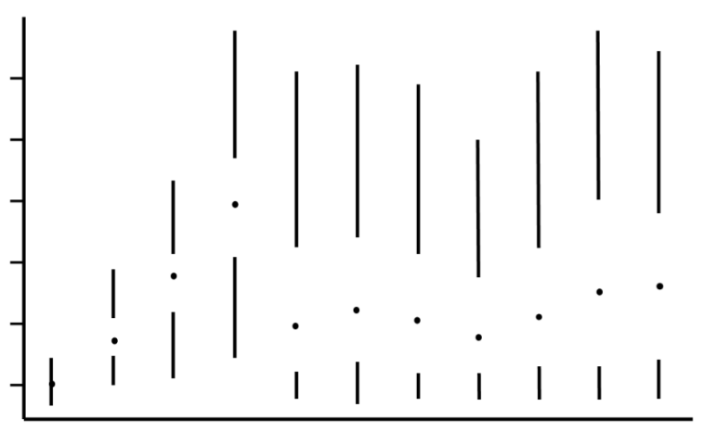
Avoid unnecessary aesthetics

Slide 34
Principles of visualization
Define what questions are you answering
Use accurate data
Experiment with ways to answer
Go with cognitive research
Faithfully represent your data
Tailor it to your audience
Make it as simple as possible
Remove everything that you can

